Slide 1

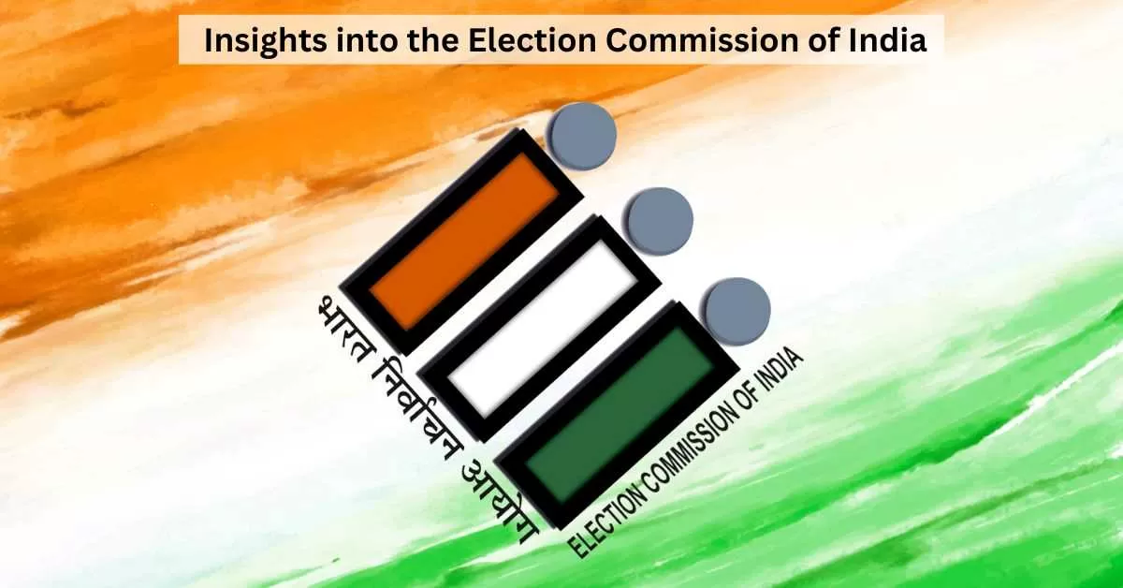
LOK SABHA ELECTION ANALYSIS
CODEBASICS RESUME PROJECT
CHALLENGE 11
Presented by
Mohan Nagrurkar

Slide 2
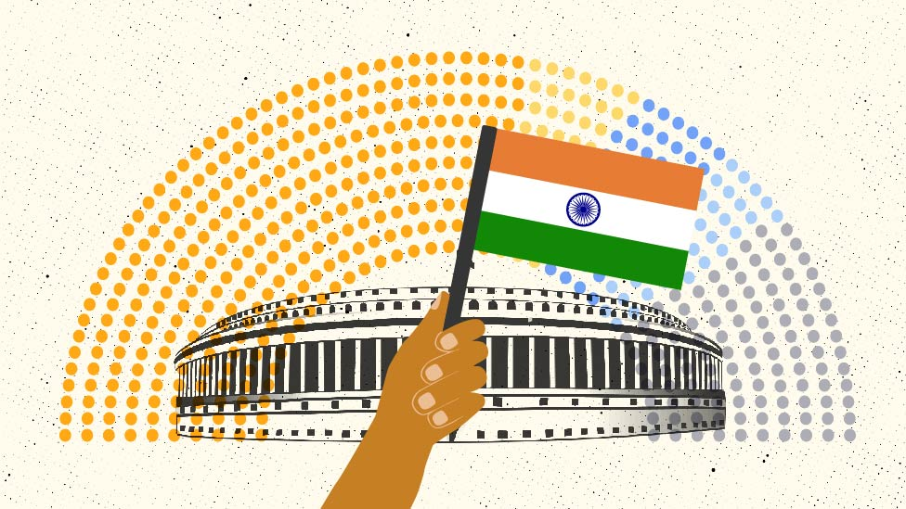
INDEX
Overview
Objectives
Dataset overview
Data Cleaning
DAX Queries
Power BI
Observations
Recommendations

Slide 3

OVERVIEW
AtliQ Media is a private media company and they wanted to telecast a show on Lok Sabha elections 2024 in India.
They wanted to present insights from 2014 and 2019 elections without any bias and discuss less explored themes like voter turnout percentage in India.
The data analyst in the company is handed over this task of generating meaningful insights from data.

Slide 4


OBJECTIVES
Clean and prepare data from datasets of Lok Sabha elections 2014 and 2019.
Create data driven metrics and visuals for analysis.
Get meaningful data and turn them into interactive insights
Create Dashboards and KPIs for better understandings

Slide 5
DATASET OVERVIEW
Datasets of Lok Sabha elections 2014 and 2019 is provided which is taken from the Election Commission of India. These are available for public access.
The Dataset consists of columns titled- State, Constituency, Candidate Name, Gender, Age, Category, Party, Party Symbol, General Votes, Postal Votes, Total Votes, Total Electors.

Slide 6
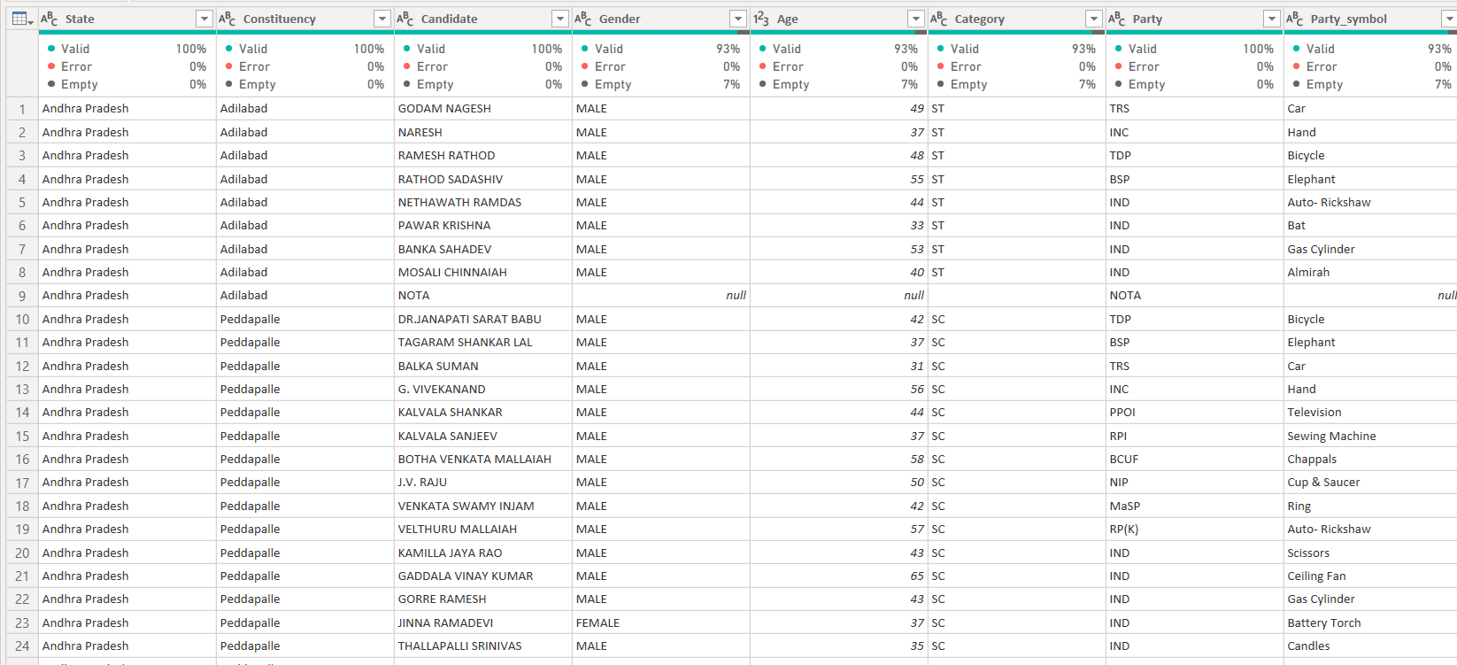
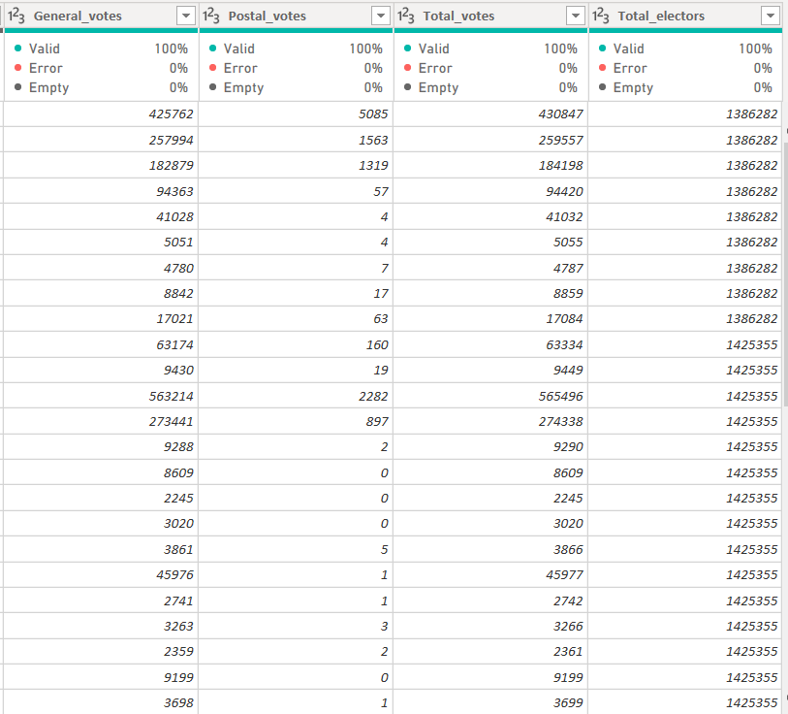
SAMPLE DATASET

Slide 7

DATASET CLEANING
Datasets of Lok Sabha elections 2014 and 2019 consists of 33 and 36 unique states. Data of Telangana, Chhattisgarh and Odisha states are missing from 2014 dataset. Although, the datasets were cleaned, but required some refining.
Both Datasets have same number of columns but entries were slightly different. For example, General Category was mentioned as ‘General’ and ‘GEN’.
Similar, data cleaning was done for gender and constituencies. Also conversion of lowercase to uppercase for some data was done.

Slide 8
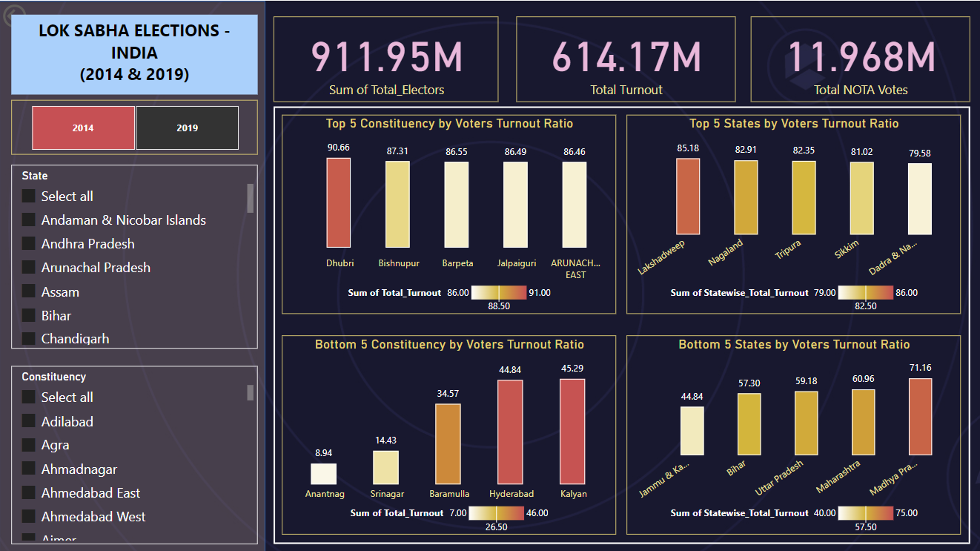
POWER BI (DASHBOARD 1)

Slide 9
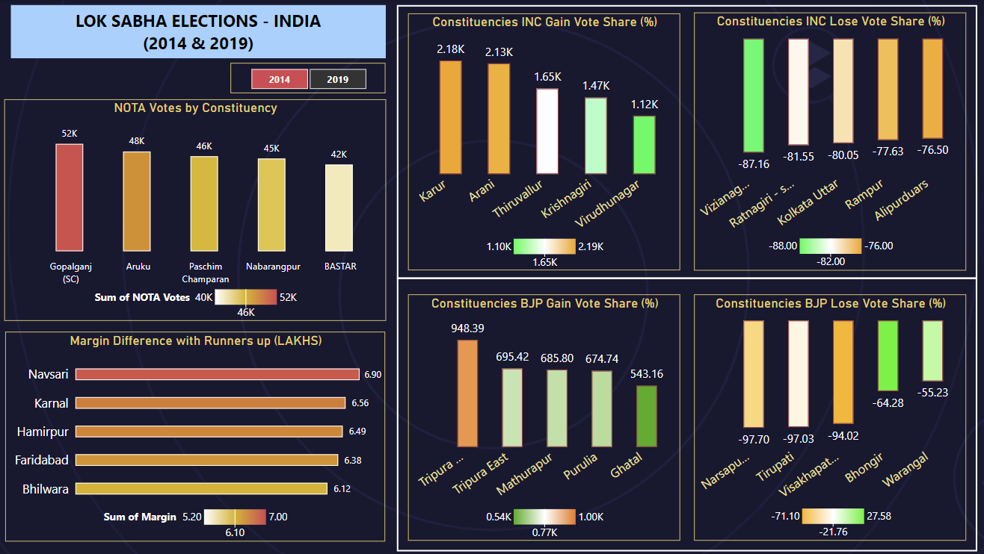
POWER BI (DASHBOARD 2)

Slide 10
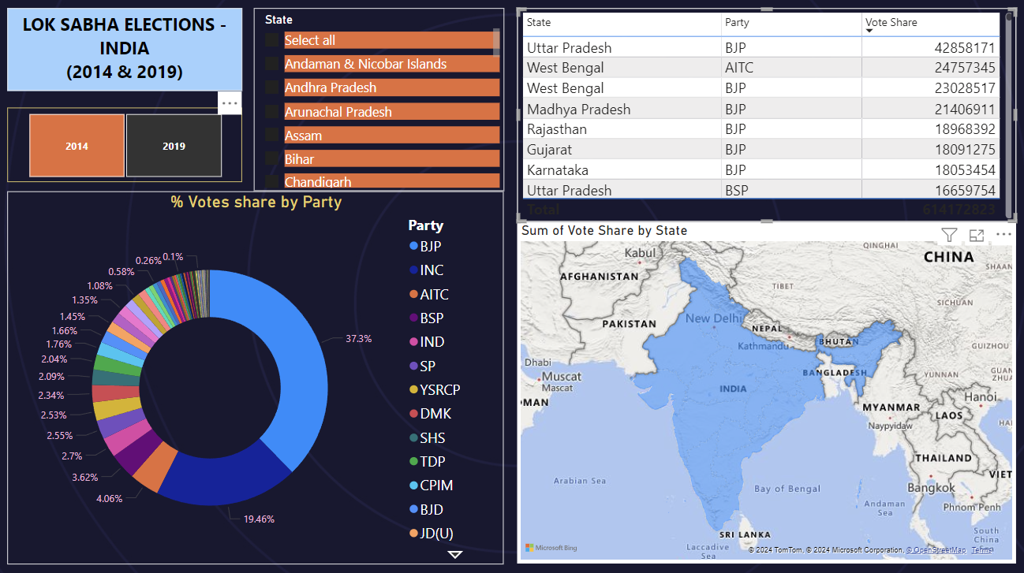
POWER BI (DASHBOARD 3)

Slide 11
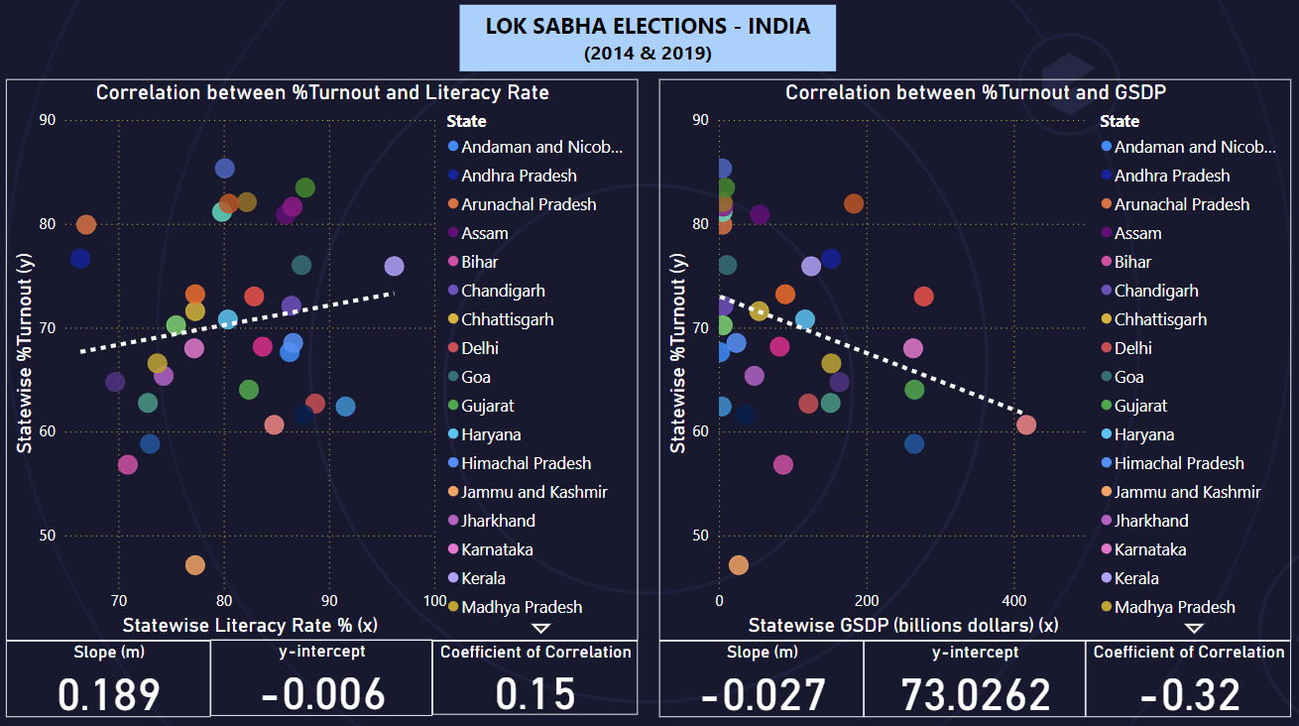
POWER BI (DASHBOARD 4)

Slide 12
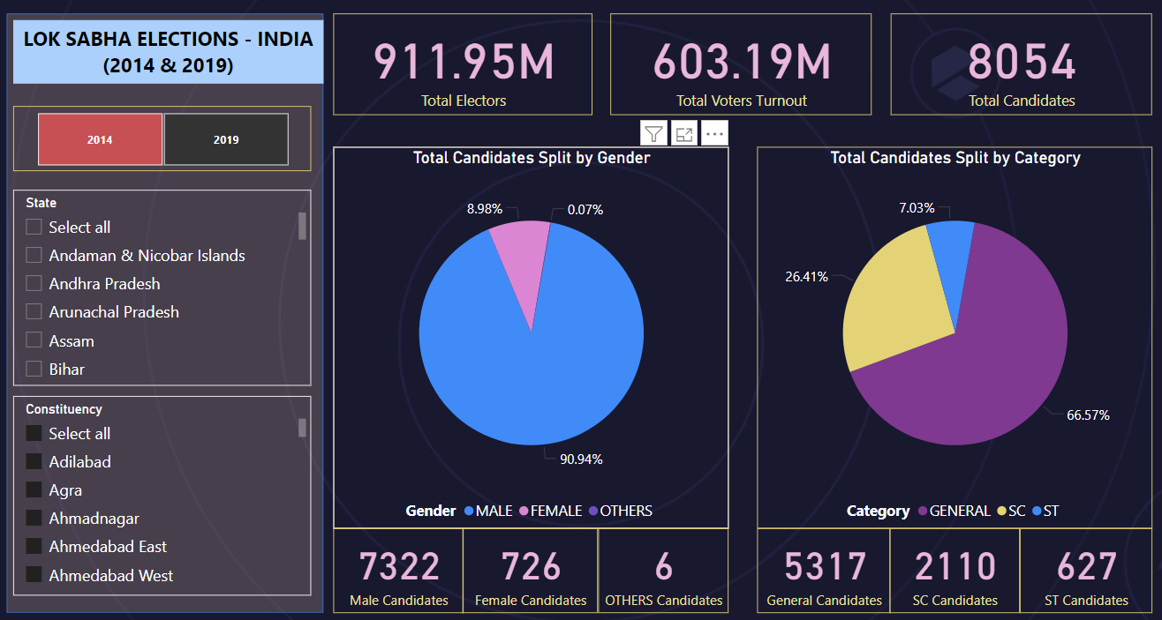
POWER BI (DASHBOARD 5)

Slide 13
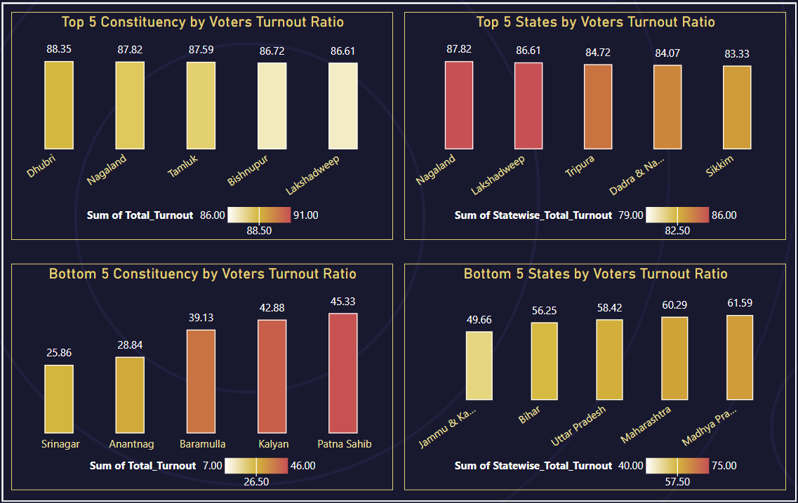
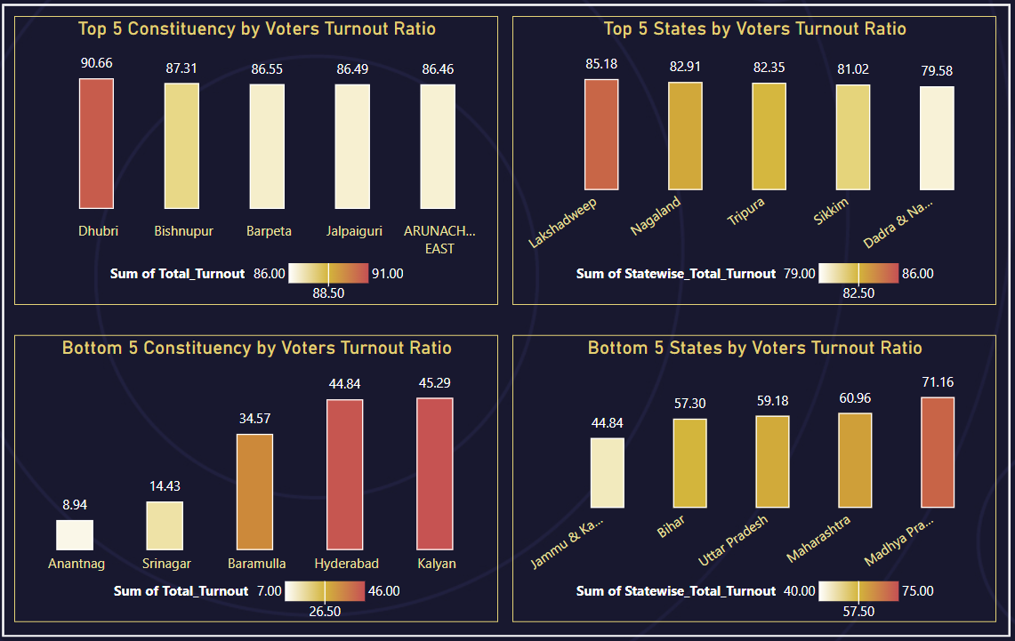
OBSERVATIONS (Voters’ turnout ratio)
In both the Lok Sabha Elections, Dhubri (Assam) reported the highest voters’ turnout as per the constituency.
Srinagar and Anantnag, which reported lowest voters’ turnout as per constituency in 2014 and 2019 respectively, belongs to Jammu and Kashmir state.
In both the Lok Sabha Elections, Jammu & Kashmir reported the lowest voters’ turnout as per the state.
Year: 2014
Year: 2019

Slide 14
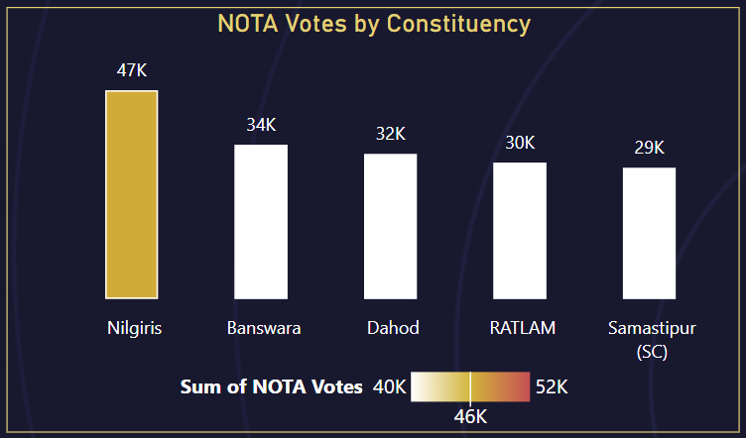
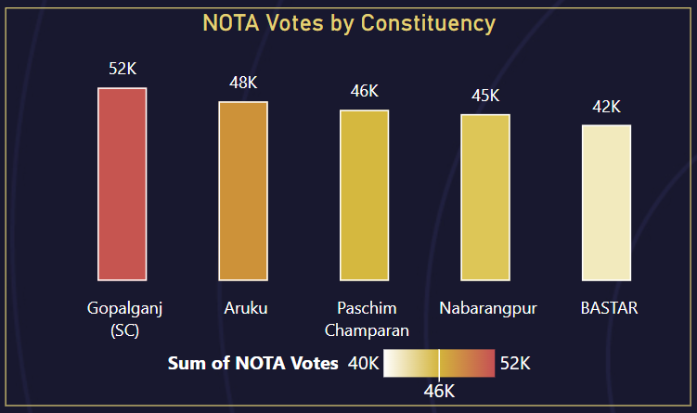
OBSERVATIONS (NOTA votes)
Nilgiris (Tamil Nadu) reported the highest NOTA votes in year 2014
while Gopalganj (Bihar) reported highest NOTA votes in year 2019 Lok Sabha elections.
It is clearly observed that there were more number of NOTA votes in 2019 than in 2014.
NOTA option was first introduced in 2013 by ECI in state assembly elections.
In 2014, most of the citizens were not aware of NOTA option and its importance.
While in 2019 LS elections, more people casted their votes for NOTA.
Year: 2014
Year: 2019

Slide 15
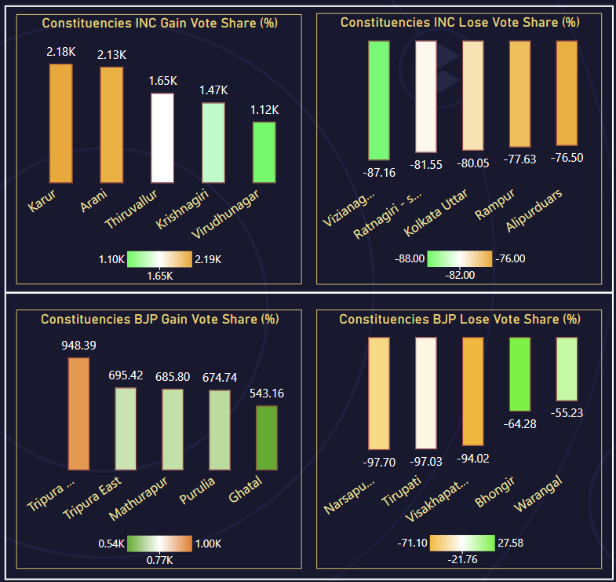
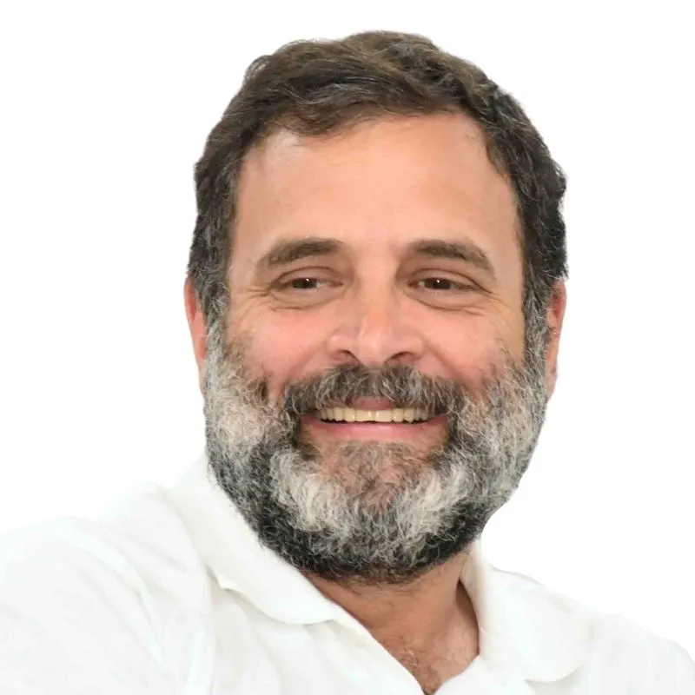
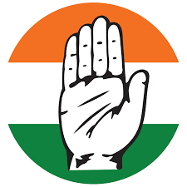
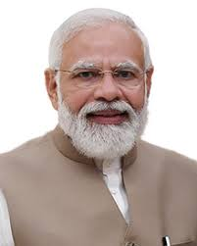
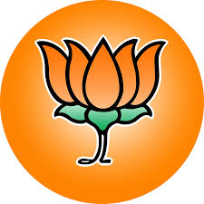
OBSERVATIONS (Performance of Top 2 National Parties)
INDIAN NATIONAL CONGRESS (INC)
INC gain votes from constituencies located in the southern part of India especially Tamil Nadu.
INC lose votes from constituencies located in West Bengal.
BHARTIYA JANTA PARTY (BJP)
BJP gained votes from constituencies located in North-Eastern and Eastern part of India especially Tripura and West Bengal.
BJP lose votes from the constituencies located in Andhra Pradesh.

Slide 16
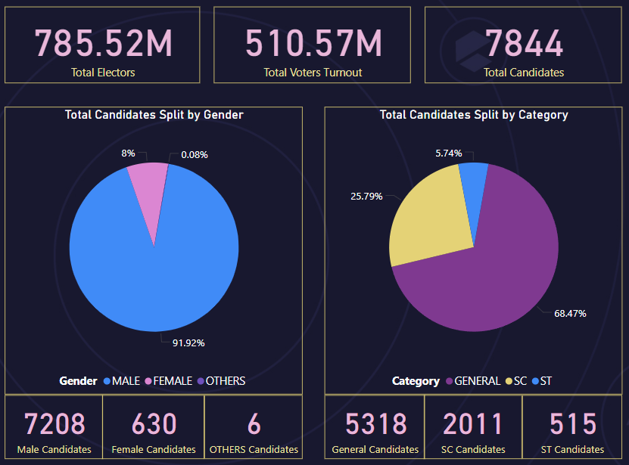
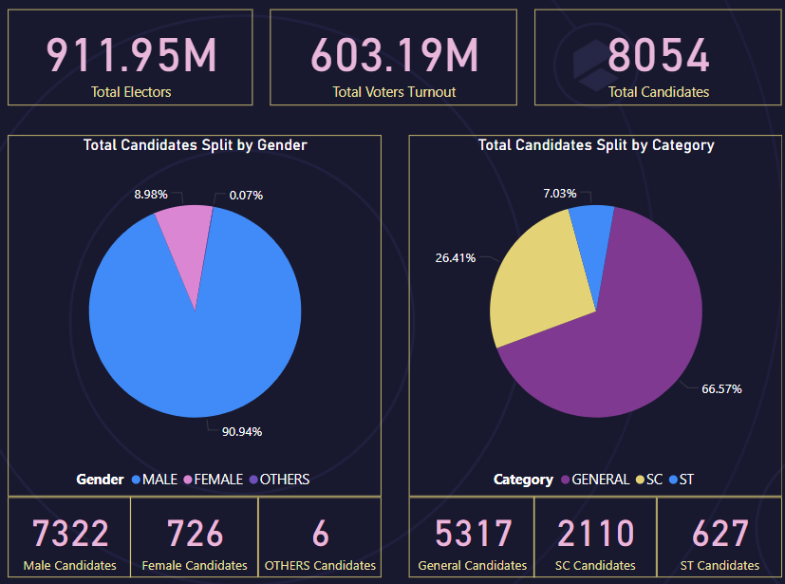
OBSERVATIONS
It is observed that Total Electors has increased in 2019 as compared to 2014.
Voters’ Turnout in 2014 : 64.99%
Voters’ Turnout in 2019 : 66.22%
The Gender ratio (Male to Female) of the candidates in 2014 was 11.44:1
while in 2019 reduced to 10.08:1.
Year: 2014
Year: 2019

Slide 17
Recommendations to increase Voters’ Turnout
Spread Voting Awareness among the citizens
Targeted Campaigns for young voters’, first-time voters, etc. shall be run specially on social media.
Online platforms should promote and disseminate the information about the importance of voting.
Voting process should be simplified and user-friendly.
Polling booths shall be easily accessible.
Reminders about the polling dates, timings, booths as per the constituencies should be send to the citizens via texts, calls, etc.
Unrepresented communities should be informed and motivated to vote.
Feedback mechanisms could be implemented to gather suggestions for improvements and feedback about the process and voting experience for future reference.

Slide 18
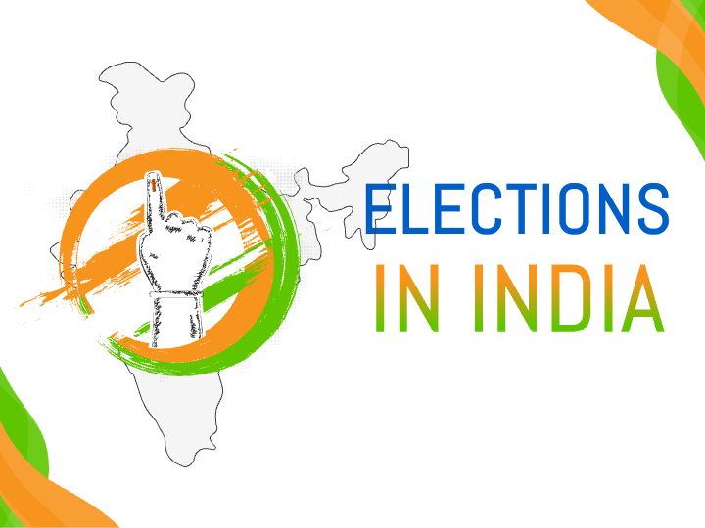
THANK YOU..
SUGGESTIONS
ARE WELCOMED

